Slide 1

DIGITAL LOGIC DESIGN (111776)
Dr. Owais Hussain

Slide 2

Agenda
Introduction
The Digital & Analog world
Basic Logic Functions
Combinational and Sequential Logic
Programmable Logic
Fixed Function Logic Devices
Measurement Instruments

Slide 3
Sample 2
Introduction
What’s beneath the digital world we see around us?
Journey from Valves (a.k.a. Vacuum tubes) to MicroNanochips
From Massive to Small
From Power-hungry to Power Efficient
From Slow to Fast
From Heat throbbing to Warm and Cozy
Binary systems – a marvel of human intelligence

Slide 4
Sample 2
The Digital and Analog World
Analog world is continuous, natural, complex, prone to noise, and beautiful.

Slide 5
Sample 2
The Digital and Analog World
Digital world is discrete, engineered, simple, accurate, fast, and ugly. In fact, it doesn’t really exist.

Slide 6
Sample 2
The Digital and Analog World
How is analog world mapped to digital? Think of the water tank in your home.
In Digital electronics, circuits have two states HIGH and LOW, represented by different voltage levels.
V_{H(max)}
HIGH
V_{H(min)}
Invalid
V_{L(max)}
LOW
V_{L(min)}

Slide 7
Sample 2
The Digital and Analog World
A pulse is described by the rise time, fall time, amplitude, and other characteristics. An ideal pulse wave doesn’t exist in physical world.

Slide 8
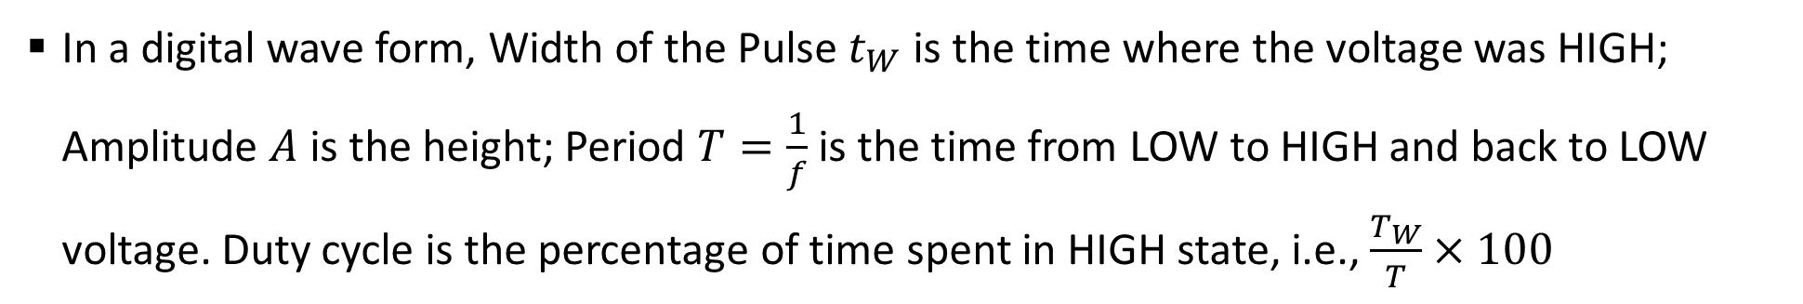
Sample 2
The Digital and Analog World
In a digital wave form, Width of the Pulse $t_{W}$ is the time where the voltage was HIGH; Amplitude $A$ is the height; Period $T=\frac{1}{f}$ is the time from LOW to HIGH and back to LOW voltage. Duty cycle is the percentage of time spent in HIGH state, i.e., $\frac{T_{W}}{T}×100$
Pulse width (t_{W})
Amplitude (A)
Period, T

Slide 9
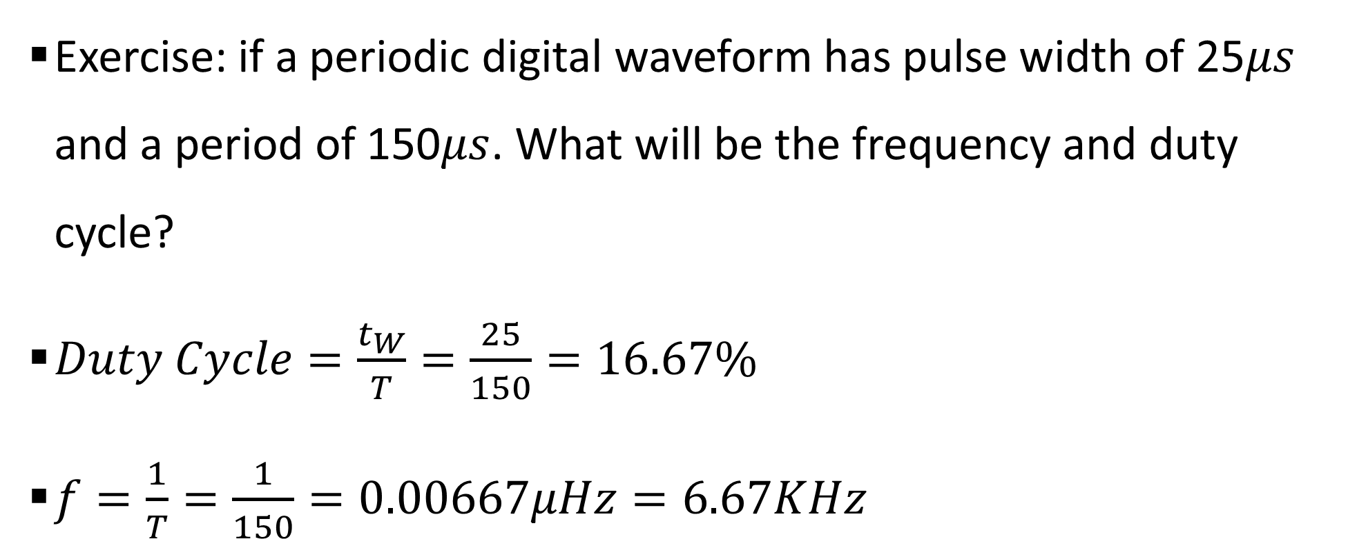
Sample 2
The Digital and Analog World
Exercise: if a periodic digital waveform has pulse width of 25$μs$ and a period of 150$μs$. What will be the frequency and duty cycle?
$Duty Cycle=\frac{t_{W}}{T}=\frac{25}{150}=16.67\%$
$f=\frac{1}{T}=\frac{1}{150}=0.00667μHz=6.67KHz$

Slide 10
Sample 2
By the way…
8 bits = 1 byte
1024 Bytes = 1 KB
1024 Kilobytes = 1MB (megabyte)
1024 Megabytes = 1GB (gigabyte)
1024 Gigabytes = 1TB (Terabyte)
10³ Hz =1kHz (kilohertz)
10⁶ Hz =1MHz (megahertz)
10⁹ Hz =1GHz (gigahertz)
10¹² Hz =1THz (terahertz)
A picosecond is 10⁻¹² of a second
10⁻³s =1ms (millisecond)
10³ s =1ks (kilosecond)
10⁻⁶ s=1 µs (microsecond)
10⁶ s =1 Ms (megasecond)
10⁻⁹ s=1 ns (nanosecond)
10⁹ s =1 Gs (gigasecond)
10⁻¹² s=1 ps (picosecond)
10¹² s =1Ts (terasecond)

Slide 11
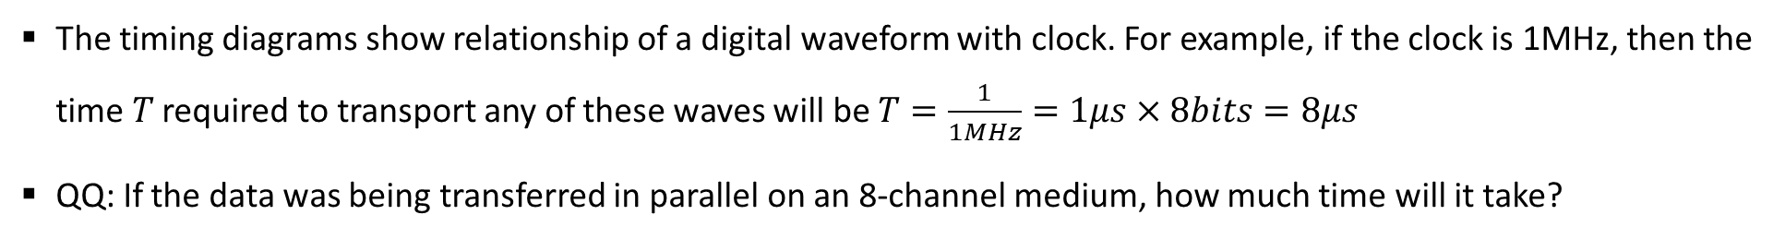
Sample 2
The Digital and Analog World
The timing diagrams show relationship of a digital waveform with clock. For example, if the clock is 1MHz, then the time $T$ required to transport any of these waves will be $T=\frac{1}{1MHz}=1μs×8bits=8μs$
QQ: If the data was being transferred in parallel on an 8-channel medium, how much time will it take?
Notes:
For parallel communication, each channel will be transferring 1bit/sec. Therefore, it’ll take 1micro second to transfer any wave.

Slide 12
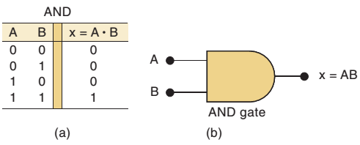
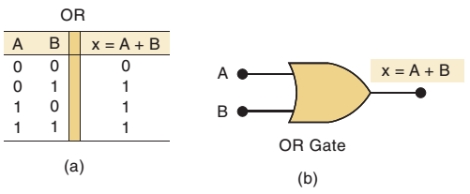
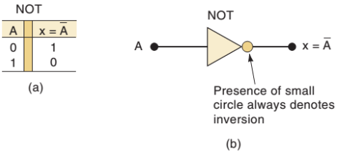
Sample 2
Basic Logic Functions
AND: True only if all input values are True
OR: True if at least one input value is True
NOT: If input is True, then False, and vice-versa

Slide 13
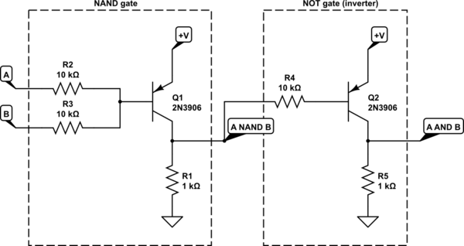
Sample 2
The Electronics behind Digital Functions/Gates
The underlying electronic circuitry
Notes:
A and B are inputs to Two Resistors. The resistors are sending signal to the Base of PNP type Transistor. Emitter is provided the voltage and Collector is grounded. The output is also collected from the Collector.

Slide 14
Sample 2
Combinational and Sequential Logic
The basic logic functions are combined to construct complex functions:
Comparator Circuits compare two inputs A and B and tell if A is greater than B; A is less than B; or A and B are equal

Slide 15
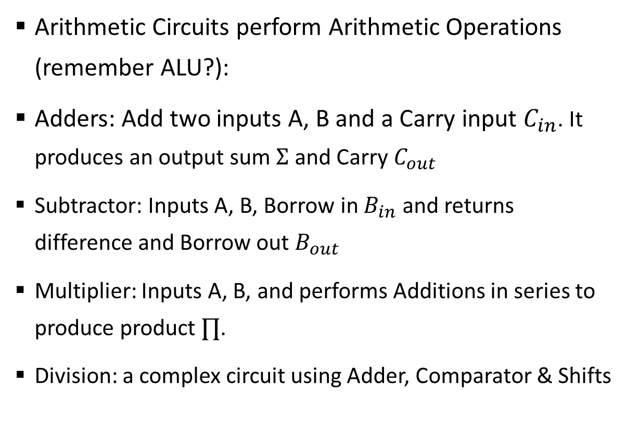
Sample 2
Combinational and Sequential Logic
Arithmetic Circuits perform Arithmetic Operations (remember ALU?):
Adders: Add two inputs A, B and a Carry input $C_{in}$. It produces an output sum $Σ$ and Carry $C_{out}$
Subtractor: Inputs A, B, Borrow in $B_{in}$ and returns difference and Borrow out $B_{out}$
Multiplier: Inputs A, B, and performs Additions in series to produce product $∏$.
Division: a complex circuit using Adder, Comparator & Shifts
Notes:
Tell the students that the Sum and Product signs are only to scare you. In your head, treat them as simple A,B,C,D

Slide 16
Sample 2
Combinational and Sequential Logic
Encoders are for conversion, such as converting Alpha-numeric input into their respective Binary code.
Decoders convert the coded values back into their original form like Decimal.

Slide 17
Sample 2
Combinational and Sequential Logic – Data Selection Circuits
Multiplexers (mux) switch data from multiple lines into single channel
Demultiplexers (demux) split data from single channel into multiple lines
Notes:
This one is a bit complicated to explain. Provide an example of how on TV we have single screen but there’s main window, then a ticker, then a side Ad. All are using separate rooms on the same screen for different types of information.

Slide 18
Sample 2
Combinational and Sequential Logic
Storage: circuits that can “memorize” information as bits.
Flip-Flops: a very-high speed alternative to Capacitors. Each circuit can store 1 bit.
Registers: Combination of Flip-Flops to store bits (8, 16, 32, …). Additionally, they can Shift bits from one Flip-Flop circuit to another.
Counters: count the number of input pulses. They generally use Flip-Flops to store the count
Notes:
Now is the good time to explain how we’ve come afar from Tape drives to Floppies to CD/DVD to HDD to SD Cards to SSD’s and now NVMe storages

Slide 19
Sample 2
Fixed Function Logic Devices
These circuits are usually packed into a monolithic IC, i.e., single electronic chip which is made to serve a fixed function.
These chips come in different packaging types:
Dual In-line Pins (DIP) are best for Lab experiments
Small Outline IC (SOIC) are soldered on Printed Circuit Boards (PCB)
Flat Pack IC (FPIC) are used by US military. They are mounted on pre-soldered brackets
Plastic-Leaded Chip Carrier (PLCC) can be installed without soldering, yet still provide the durability close to a soldered chip
Leadless Ceramic Chip Carrier have no leads on the chip
Notes:
Tell the students that there’s no significance whatsoever in the way the chips are packaged except the convenience of putting on a circuit board. The function still remains the same.

Slide 20
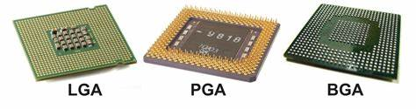
Sample 2
Fixed Function Logic Devices
Modern Computer Microchips mostly use three types of packaging:
LGA: Land Grid Array is used by Intel in Desktop and Server Processors. AMD’s Epyc and Threadripper series CPU also uses the same packaging.
PGA: Pin Grid Array is used by AMD for their Ryzen Processors. Intel also used this in the past for their Pentium, Celeron and Core series CPUs.
BGA: Ball Grid Array is rarely used these days. They are nearly impossible to upgrade, inspect, or replace once the chip is soldered on the board.
Notes:
Tell the students that there’s no significance whatsoever in the way the chips are packaged except the convenience of putting on a circuit board. The function still remains the same.

Slide 21
Sample 2
Programmable Logic
Programmable logic devices can be used for multiple purposes, as opposed to fixed circuits.
Though, it is faster to implement custom logic with PLD’s, they are often not as efficient as fixed-logic devices.
Simple PLD: can replace up to 10 fixed IC’s. These are generally either PAL (Programmable Logic Array) which can be programmed only once, GAL (Generic Logic Array) which can be programmed multiple times, or PROM (Programmable Read-Only Memory).
Complex PLD: multiple SPLD circuits bundled into a single chip. They can hold up to 64 LAB (Logic Array Blocks), where each block is essentially a SPLD. A CPLD can be used to implement almost any circuit discussed in this course.
Field-Programmable Gate Array (FPGA): CPLD’s with separate Programmable Logic blocks and I/O blocks.

Slide 22
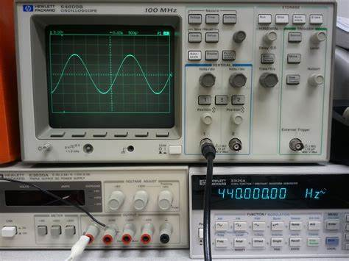
Sample 2
Measurement Instruments
Oscilloscope: shows a graph of how signal changes over time
A voltage probe is connected to the source and the oscilloscope shows how the voltage levels are changing on the source.
Digital oscilloscope uses ADC (Analog-Digital Converter) to convert the signal into digital form and render on the display.

Slide 23
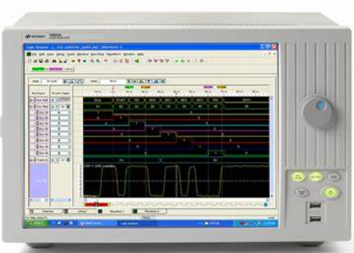
Sample 2
Measurement Instruments
Logic Analyzer measures multiple digital signals, since Oscilloscope only has 1 to 4 inputs.
These devices were designed to debug Microprocessors, and have 16 to 136 input probes.
It offers many functions, but primarily it converts the signals into timing diagrams for analysis.

Slide 24
Sample 2
Measurement Instruments
Analyzer probes are simply a collection of probes to connect a circuit with digital analyzer.
A logic pulser produces a pulse wave periodically to any point in the circuit.
A DC Power Supply is used to provide current to a circuit. It has tuners to control the output volage and current to supply. Your phone and laptop chargers are also DC power supplies with fixed voltage and current.
A Digital multimeter provides a wide range of functions, including measurement of current, voltage, resistance, testing a transistor, testing circuit closures, checking diodes and capacitors, taking frequency measurements. A DMM is considered the most essential equipment on any workbench.

Slide 25
Sample 2
Activity
A GPU (Graphic Processing Unit) has 192-bit bus width. It is rendering a 10 second animation at 60 frames/second. Each image is roughly 24KB in size. Assuming the frequency at which the GPU is operating is 1200Mhz, how long will it take for the GPU to transfer all of this data?
Notes:
You have 10 seconds x 60 frames/second x 24 KB/image = 14,400 KB.
The speed of the GPU is 192-bit x 1200 MHz = 230,400 Mbps.
Therefore, the data transfer time is 14,400 KB / 230,400 Mbps = 0.0005 seconds.

Slide 26
Sample 2
Assignment
What is CMOS – BIOS Chip? How are these chips programmed and configured in modern computers?
What are VLSI and ULSI chips? Which category does an Intel’s Celeron CPU Model N4020 fits in?

Slide 27



THANK YOU
Owais Hussain
+92 345-3174270
owais.hussain@kiet.edu.pk
https://www.researchgate.net/profile/Owais-Hussain-3

